Slide 1



SMART INDIA HACKATHON 2026
Flash Flood Prediction System for Hilly Regions using Multi-Source Data
Problem Statement ID – 26192
Problem Statement Title – Flash Flood Prediction System for Hilly Regions using Multi-Source Data
Theme – Disaster Management
PS Category- Software
Team ID –
Team Name – INTELLIVERSE

Slide 2
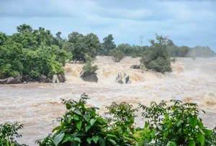
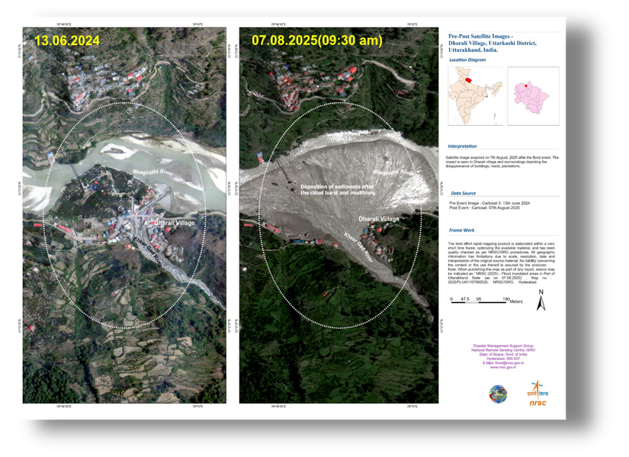


























Pravah AI : Flash Flood Prediction System for Hilly Regions
INTELLIVERSE
THE PROBLEM
OUR IDEA'S PROCESS FLOW (AT A GLANCE)
Flash floods in hilly regions occur with very short warning times, making evacuation difficult.
Existing systems lack hyper-local, village/ward-level prediction.
Rainfall, soil moisture, slope and historical data are not sufficiently integrated.
RAINFALL DATA
SOIL MOISTURE
SLOPE STABILITY
HISTORICAL DATA
IOT REAL-TIME INPUTS
IMD, CWC AND NBDI.
Historical soil moisture data
DEM, slope angle, land cover
Landslides, flash floods, past events
Rain gauges, river level.
DATA FUSION & PREDICTION ENGINE
AI/ML models analyze combined signals to estimate flash-flood risk
Flash Flood Disaster: Dharali Village, Uttarkashi District, Uttarakhand. (NDMA) Aug, 2025.
PROPOSED SOLUTION
PRAVAH AI is an AI-based flash-flood prediction system designed for hilly regions. It uses historical and environmental data to predict flood risk and provide localized warnings.
Predictive Risk Engine: Analyses combined data to identify emerging flash-flood risk.
Hilly-Region Focus: Designed specifically for flash-flood prediction in hilly areas, considering the role of terrain and slope.
HYPER-LOCAL RISK FORECAST
INNOVATION/ UNIQUENESS
Generates risk prediction at village / ward level
Alternative Routing System: Suggests safer alternative routes during a flood-risk situation, helping people avoid potentially affected areas.
Catchment-Level Prediction: Provides catchment-specific flood risk instead of broad district/state-level warnings.
Explainable & Actionable: SHAP-based risk explanations + human-reviewed alerts + safe-route guidance turn predictions into actionable decisions.
EARLY WARNING SYSTEM
Provides risk level, affected location and available lead time
ACTIONABLE RESPONSE
Enables timely evacuation, preparedness and risk mitigation
@SIH Idea submission- Template
2
Notes:
2

Slide 3
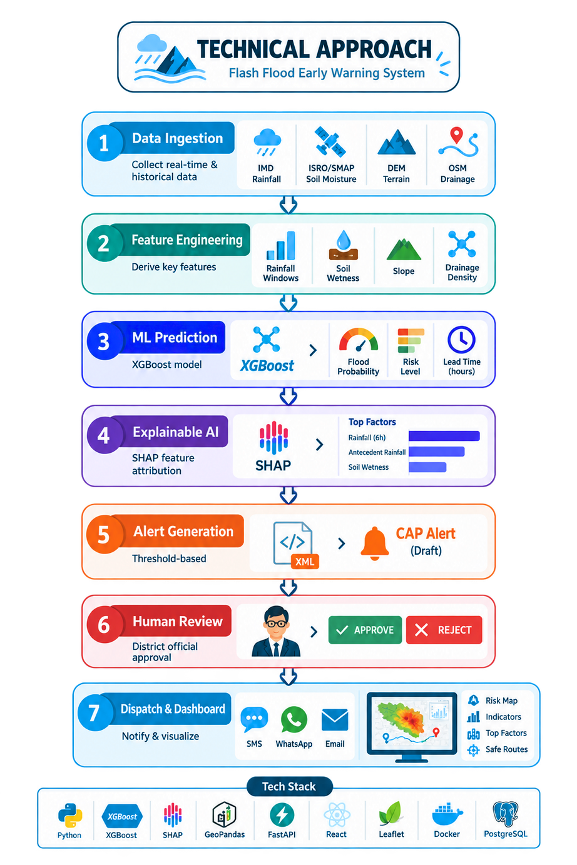
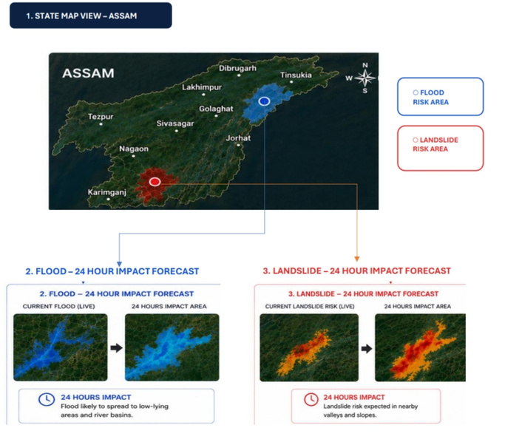
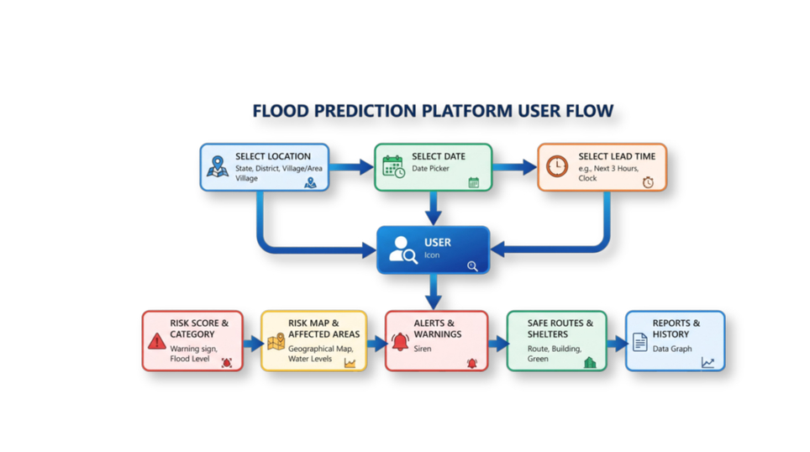
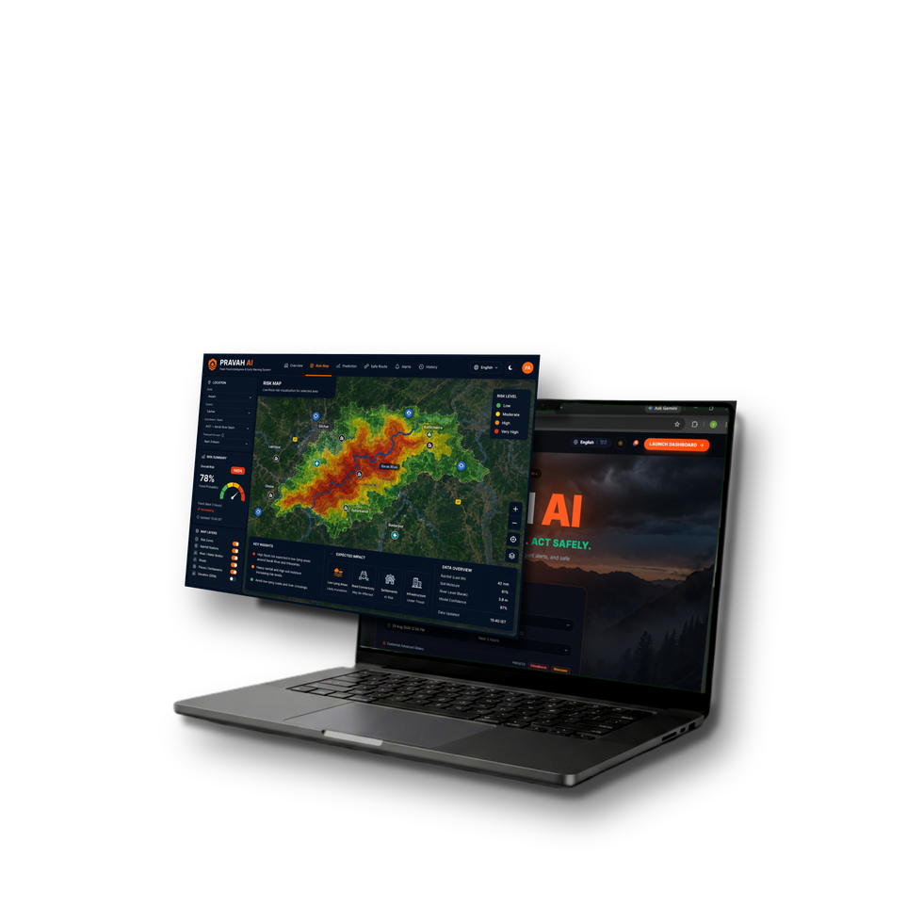













TECHNICAL APPROACH
INTELLIVERSE
METHODOLOGY FLOWCHART
USER INTERFACE
USER EXPERIENCE PATHWAY
Pravah AI : User Flow
Select Location: Choose State, District, and Village/Area for the flood-risk assessment.
Select Date: Choose the date for prediction.
Select Lead Time: Select the prediction window, e.g., Next 3 Hours.
Submit Request: Submit the selected details for PRAVAH AI analysis.
View Risk Assessment: View the predicted risk score and category.
View Risk Map: View the risk map and potentially affected areas.
Receive Alerts & Warnings: Get alerts when significant flood risk is detected.
Check Safe Routes & Shelters: View safer routes and available shelters.
Access Reports & History: View generated reports and previous risk information.
🔴 Live Demo (click)
Send approved alerts
Maintain reports and logs
JS
XGBoost
OR-Tools
React
Mapbox
Node.js
MongoDB
Python
XGBoost
Google OR-Tools
@SIH Idea submission- Template
3
Notes:
3

Slide 4





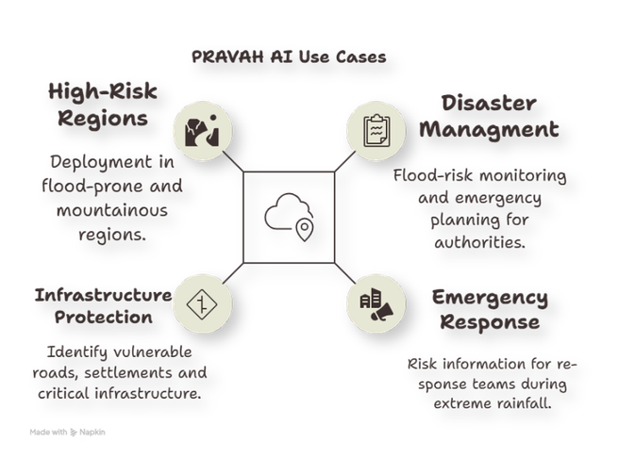

INTELLIVERSE
FEASIBILITY AND VIABILITY
equipment health monitoring, AI-driven anomaly detection, adaptive control, process modeling, environmental sustainability, mining modernization, Industry 4.0, real-time decision support,machinelearningregressionmodels,powerusageefficiency,vibrationanalysis,energybenchmarking,predictiveanalytics,bigdatainmining,AI-enabledmaintenance,digitaltransformationinmining,processoptimizationframework,integratedenergymonitoringsystem,optimization
pipeline, AI algorithm for throughput, automated reporting, dashboard visualization, safety and compliance, production planning, energy efficiency metrics, energy intensity reduction, processvariabilitycontrol,industrialdataingestionpipeline,communicationnetworkinmining,scalablesoftwarearchitecture,secureAPIlayer,front-enddashboard,React,Node.js,
Feasibility :
Challenges & Mitigations :
Development : MVP with AI prediction, dashboard, risk maps and alerts can be developed in 6–8 weeks.
Data Feasibility : Historical rainfall, river, terrain and flood-event data can train the models.
Technical Feasibility : Python, XGBoost, LSTM, Node.js, all open-source and proven tools
Operational Feasibility : Automated alerts with human review only at dispatch; minimal manpower needed.
Data Scarcity: Limited flood-event data can restrict model learning. Multiple data sources strengthen training.
Limited ground data: Public data initially; more sensors can be added later.
False Alarms: Incorrect warnings may reduce confidence. Probability-based risk classification and continuous validation improve reliability.
User Trust & Adoption: AI predictions may be difficult to understand. SHAP-based explanations make predictions transparent.
Viability :
Modular Implementation : Phased deployment enables easy implementation and scaling.
Cost-Effective Pilot : Existing datasets and cloud infrastructure keep initial costs low.
System Scalability : Can expand from one district to multiple flood-prone regions.
Future-Ready Platform : Real-time sensors, satellite updates and crowdsourced data can be integrated as the system expands.
Use Cases :
Flood monitoring and emergency planning for authorities.
Deployment across flood-prone and mountainous areas.
Risk information for response teams during extreme rainfall.
Identifying vulnerable roads and critical infrastructure.
PRAVAH AI
@SIH Idea submission- Template
4
4

Slide 5













IMPACT AND BENEFITS
INTELLIVERSE
IMPACTS
BENEFITS
COMPARISION
01
Broad
Localized Risk
SOCIAL
Warnings
Timely last-mile alerts
Multi-Source Data
Better community preparedness
Clear, timely alerts help residents prepare and evacuate when necessary.
Single Data
Explainable risk information
Source
02
ECONOMICAL
Prediction + Dashboard
Supports early protective action
Alert-Focused
Real-time risk dashboard enable faster evacuation orders
Helps reduce avoidable losses
Authority-
Community + Authority
Uses affordable tech stack
FARMERS & RURAL COMMUNITIES
Centric
03
ENVIROMENTAL
03
Advance alerts minimise crop and livestock loss before flash flood onset
System-
Replicable & Scalable
Catchment-level monitoring
Specific
Planning of relief resources
Climate-resilient planning
04
SCALABILITY
Risk-aware routing helps identify safer routes during flood conditions.
Existing
Adaptable to other hazards
Pravah AI
Replicable across regions
Solutions
National multi-hazard base
@SIH Idea submission- Template
5
Notes:
5

Slide 6
INTELLIVERSE
RESEARCH AND REFERENCES
REFERENCES VALIDATION
RESEARCH PAPERS
DATA SOURCES
Problem Gap Inadequate EWS in India:
Chen, T. & Guestrin, C. (2016). XGBoost: A Scalable Tree Boosting System
India Meteorological Department (IMD): Rainfall & Weather Data
Why Existing Systems for Floods Fall Short
Link
Link
Is India Ready with an Early Warning System?
Lundberg, S. M. & Lee, S. I. (2017). A Unified Approach to Interpreting Model Predictions
ISRO Bhuvan: Satellite & Geospatial Data
Multi-Source Data
ML Techniques for Soil Moisture Modeling
Link
Link
Shallow Slope Stability Under Extreme Rainfall
ML / XGBoost Prediction Engine
Farr, T. G. et al. (2007). The Shuttle Radar Topography Mission
NDMA: Disaster Management & Flood Risk Information
Outrunning Flash Floods: XGBoost & Sparse Impact Reports
Link
Link
Agentic Explanation & Alert Layer
Sadkou et al. (2024): A review of flash-floods management: From hydrological modeling to crisis management
OTHER DATA STUDIED :
Flood Management & Risk Communication via LLMs
Uttarkashi, Uttarakhand: Flash-Flood Case Study
Assam: Flood-Prone Regional Case Study
Evacuation Routing Engine Research
Link
NDRF Flood Operations 2023 - Rescue & Evacuation Data
@SIH Idea submission- Template
6
Notes:
6

